Slide 1
CRISIS, RECOVERY & CONVERSION
WELCOME TO WEEK 13

Slide 2
Q & A:
?

Slide 3
ABOUT PLOTINUS
PLATO’S THEORY OF FORMS, 4TH CENTURY BCE: IDEAL REALM, ETERNAL, ALL NATURAL MANIFESTATIONS ARE INFERIOR; IGNORE THEM
PROBLEM: NO ACCOUNT OF HOW THE TWO REALMS RELATE
ARISTOTLE’S THEORY OF “THE UNMOVED MOVER” IDEAL, ETERNAL, THE SOURCE OF ALL CREATION
DIFFERENCE: THE NATURAL WORLD IS WORTHY OF STUDY
PROBLEM: WHY IS IT WORTHY OF STUDY?
POSSIBLE SOLUTION: EMBRACE PLATO’S THEORY, BUT DEFINE THE RELATIONSHIP BETWEEN LOW & HIGH

Slide 4
PLOTINUS ON CONSCIOUSNESS
POSITS A DYNAMIC, ONGOING RELATIONSHIP BETWEEN THE ETERNAL (UNIVERSAL) SOUL AND THE INDIVIDUAL SOUL
OUR SOULS ARE TRAPPED IN A PHYSICAL SHELL
THE BODY EXPERIENCES THINGS
OUR SOULS STAND BETWEEN CREATION & UNIVERSAL SOUL
AN ETERNAL, UNIVERSAL PRESENCE IN WHICH WE PARTICIPATE
CONCEPTS IN PHILOSOPHY vs. CONCEPTS IN THEOLOGY?

Slide 5
THIS WEEK:
READ CHAPTERS 14 & 15
ENCOMIUM OF (THEN-PAGAN) EMPEROR CONSTANTINE
EUSEBIUS OF CAESARIA ON THE CONVERSION OF (NOW-CHRISTIAN) EMPEROR CONSTANTINE

Slide 6
(Don’t laugh, it still runs…)

Slide 7
THE ROMAN EMPERORS—A RECAP…
25 IN ALL (ACCORDING TO THE SENATE), PRIOR TO 235 CE
12 ASSASSINATED (CAESAR, CALIGULA, GALBA,VITELLIUS, DOMITIAN, COMMODUS, PERTINAX, DIDIUS JULIANUS, CARACALLA, MACRINUS, ELAGABOLUS, SEVERUS ALEXANDER)
2 COMMITTED SUICIDE (NERO, OTHO)
2 POSSIBLY POISONED (AUGUSTUS, CLAUDIUS)
1 DRIVEN TO AN EARLY GRAVE (NERVA)
9 DIED OF NATURAL CAUSES – SO FAR AS WE KNOW (TIBERIUS, VESPASIAN, TITUS, TRAJAN, HADRIAN, ANTONINUS PIUS, MARCUS AURELIUS, SEPTIMIUS SEVERUS)

Slide 8
WHAT WOULD A ‘NORMAL’ EMPEROR LOOK LIKE? WHAT WOULD CONSTITUTE “CHAOS” IN THIS SYSTEM?
QUESTIONS:

Slide 9
CRISIS & CHAOS, OR COMPLEMENTARY INSTITUTIONS?
SENATE—RETAINS POWER TO GRANT IMPERIUM, DIVINE STATUS (AN ABSOLUTE MUST-SEE, IF YOU WANT POWER)
PRAETORIAN GUARD—DEMAND & GET THE POWER TO NOMINATE & ASSASSINATE EMPERORS
PROVINCIAL GOVERNORS—(APPOINTED BY SENATE & EMPEROR) RETAIN THE OPTION TO DECLARE THEMSELVES EMPERORS
PROVINCIAL LEGIONS—DEMAND & GET THE POWER TO ACCLAIM & ASSASSINATE EMPERORS

Slide 10
OTHER VARIABLES:
HUMAN NATURE—FICKLE, BUT PRONE TO AMBITION & A WILLINGNESS TO KILL TO GET WHAT THEY WANT
PERSIANS – ONCE BACK IN POWER, THEY SEEK TO RECOVER LOST TERRITORY (ASIA MINOR, PALESTINE, etc.)
NORTHERN TRIBES – OFTEN FORCED TO INVADE ROMAN LANDS, TO AVOID UTTER ANNIHILATION FROM INVADERS TO THEIR OWN NORTH
EASTERN TRIBES – DITTO…

Slide 11
FAIRY TALES vs. REALITY
ARE WE PROJECTING NAÏVE NOTIONS OF HOW EMPIRES ARE FORMED, HOW THEY OPERATE, & HOW THEY SURVIVE?
DID CONTEMPORARY HISTORIANS FULLY COMPREHEND THE SOCIETY (AND SYSTEM) OF WHICH THEY WERE A PART?
DID CONTEMPORARIES DIRECTLY INVOLVED IN THE ACTION SEE THIS AS ‘CHAOS,’ OR AS ‘BUSINESS AS USUAL’?
HOW SURPRISING IS IT SUPPOSED TO BE, REALLY?
SHOULD WE FOCUS ON HOW THE SYSTEM SURVIVED, INSTEAD OF ON HOW IT MIGHT HAVE FALLEN APART?

Slide 12
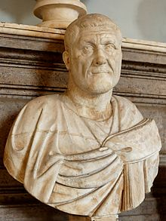
MAXIMINUS THRAX
235-238 CE
BUILT LIKE A LINEBACKER
PRIVATE-TO-EMPEROR (THE FIRST OF MANY)
AVOIDS ROME (SMART MOVE?)
DEMANDS EVERYONE ACTUALLY PAY THEIR TAXES
MURDERED BY HIS OWN, MARCHING ON ROME

Slide 13
GORDIAN I & GORDIAN II MARCH-APRIL 238 CE

Slide 14
AUGUSTI FOR THREE WEEKS !?!
FATHER-SON TEAM
ACCLAIMED UNDER DURESS
SENATE APPROVAL SOUGHT (& GAINED)
RAG-TAG MILITIA NO MATCH FOR THE III AUGUSTA LEGION
(FOR THEM, THEN AGAINST THEM)

Slide 15
PUPIENUS & BALBINUS APRIL-JULY 238 CE

Slide 16
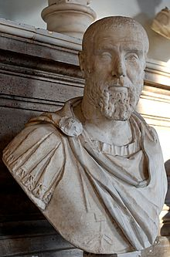
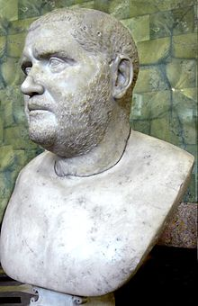
THE SENATE’S LAST HURRAH

Slide 17
THE HISTORIAN’S DILEMMA
MAXIMINUS IS STILL ALIVE, STILL HAS (SOME) LEGIONS ON HIS SIDE, MARCHING ON ROME
HE ONLY LACKS SENATORIAL APPROVAL—BUT DOES IT MATTER?
ARE WE TAKING THE (ALLEGEDLY IRRELEVANT) SENATE’S SIDE WHEN WE CROWN THE GORDIANS, PUPIENUS & BALBINUS?
WHOSE SIDE ARE WE ON, ANYWAY?

Slide 18
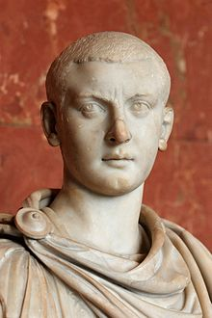
GORDIAN III, 238-244 CE
IN ROME DURING HIS GRANDDAD’S & UNCLE’S ATTEMPTED COUP
PUPIENUS & BALBINUS MAKE HIM CAESAR
PRAETORIAN GUARDS DO THEIR THING
13-YEAR-OLD EMPEROR !! (i.e., TIMESITHEUS TAKES CHARGE)
TIMESITHEUS ‘DIES,’ PHILIP STEPS IN
PHILIP, NOW PRAETORIAN PREFECT, DOES HIS THING, so…

Slide 19
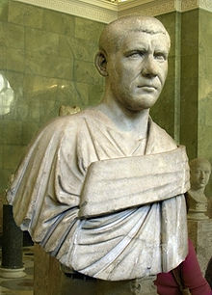
PHILIP, 244-249 CE
“THE ARAB” (PHOENICIAN, EQUITES)
PREFECT-NOW-EMPEROR (AGAIN)
DEIFIES GORDIAN III (HIS VICTIM) TO GAIN SENATE APPROVAL
HIS 6-YEAR-OLD SON’S A CAESAR !!
CREATES NEW OFFICE: RECTOR ORIENTIS
FACED WITH USURPERS GALORE
KILLED BY DECIUS ON THE DANUBE

Slide 20
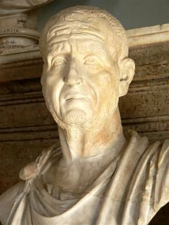
TRAJAN DECIUS, 249-251 CE
ROMAN PREFECT, SENT TO THE DANUBIAN PROVINCES
SUCCESSFUL AGAINST THE GOTHS (BUT ONLY AT FIRST)
ELEVATED BY HIS TROOPS (NATCH)
CHRISTIAN PERSECUTIONS
FIRST EMPEROR TO DIE IN BATTLE
THE GOTHS, NOW VICTORIOUS, POUR INTO ROMAN TERRITORY

Slide 21
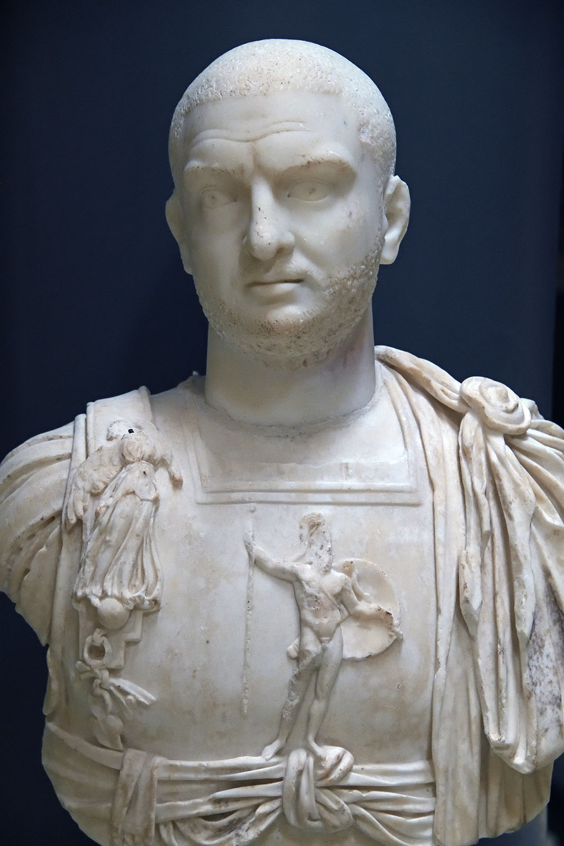
TREBONIANUS GALLUS, 251-253 CE
PERSIAN DESCENT
DECIUS’ TRUSTED GENERAL, ELEVATED UPON DECIUS’ DEFEAT
BACK IN ROME, DECIUS’ WIFE AND SON GRANTED AUGUST STATUS
PERSIANS & PLAGUES & GOTHS COMBINE AGAINST HIM, so…
MORE CHRISTIAN PERSECUTIONS
MURDERED BY HIS OWN TROOPS, IN FAVOR OF GOTH-KILLER:

Slide 22
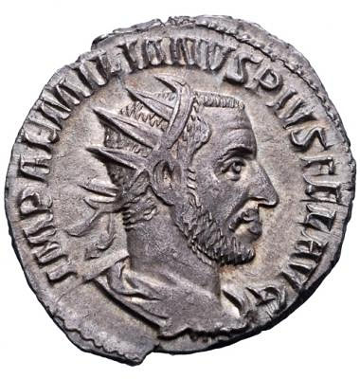
AEMILIANUS, 253 CE
EMPEROR FOR THREE MONTHS
NORTH AFRICAN DESCENT
ELEVATED BY HIS LEGIONS, AFTER DEFEATING THE GOTHS
SENATE-APPROVED, TOO !!
PROBLEM: ANOTHER GENERAL FROM THE RHINE CHALLENGES HIS RULE
HIS OWN TROOPS KILL HIM IN FAVOR OF…

Slide 23
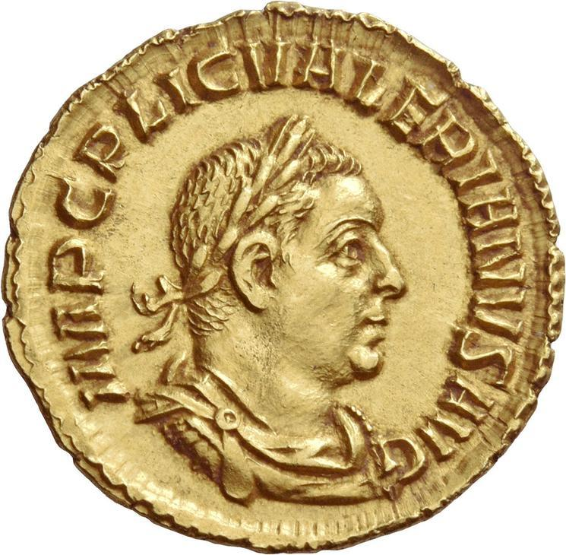
VALERIAN, 253-260 CE
ALLY OF TREBONIUS GALLUS
MARCHES ON ROME TO DEFEND HIM
ELEVATED BY HIS TROOPS, WHEN GALLUS IS MURDERED
CONTINUES HIS MARCH: AEMILIANUS MURDERED NEXT
SENATE-APPROVED, HIS SON MADE CAESAR & SENT WEST
DEFEATED & KILLED BY SHAPUR

Slide 24
VALERIAN’S SURRENDER TO SHAPUR I

Slide 25
AHURA-MAZDA CROWNS THE SASSANIDS

Slide 26
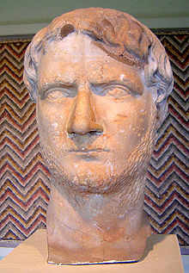
GALLIENUS, 253-268 CE
VALERIAN’S SON & AUGUSTUS; WESTERN PORTFOLIO
FOUNDER OF MOBILE FORCES (VEXILLATIONES)
CULTURAL RENAISSANCE
FIRST EDICT OF TOLERANCE FOR CHRISTIANS
ABOLISHES THE SENATE’S MILITARY ROLE/PRIVILEGES
USURPERS GALORE
ASSASSINATED (BY HIS OWN)

Slide 27
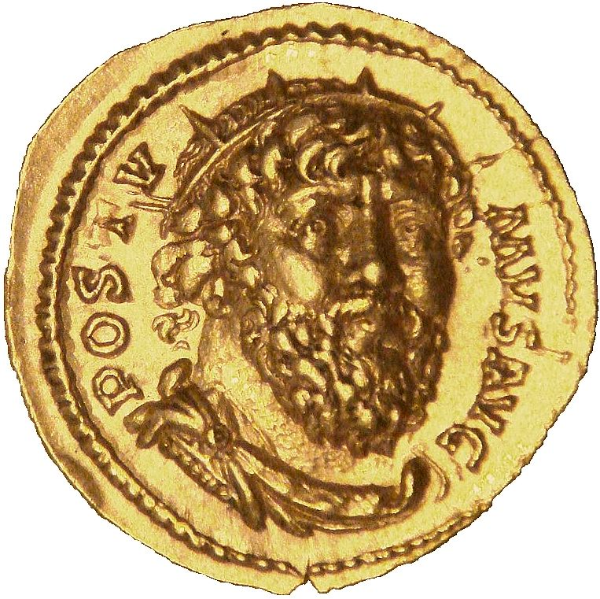
POSTUMUS, 260-268 CE
APPOINTED BY VALERIAN; WESTERN PORTFOLIO
GALLIENUS NOMINATES HIS SON TO TAKE OVER AFTER VALERIAN
POSTUMUS MURDERS THE SON, GALLIENUS TOO BUSY TO RESPOND
“RESTORER OF GAUL” BUT ONLY FOR AWHILE
HE & HIS OWN SON MURDERED (BY HIS OWN, HO HUM)

Slide 28
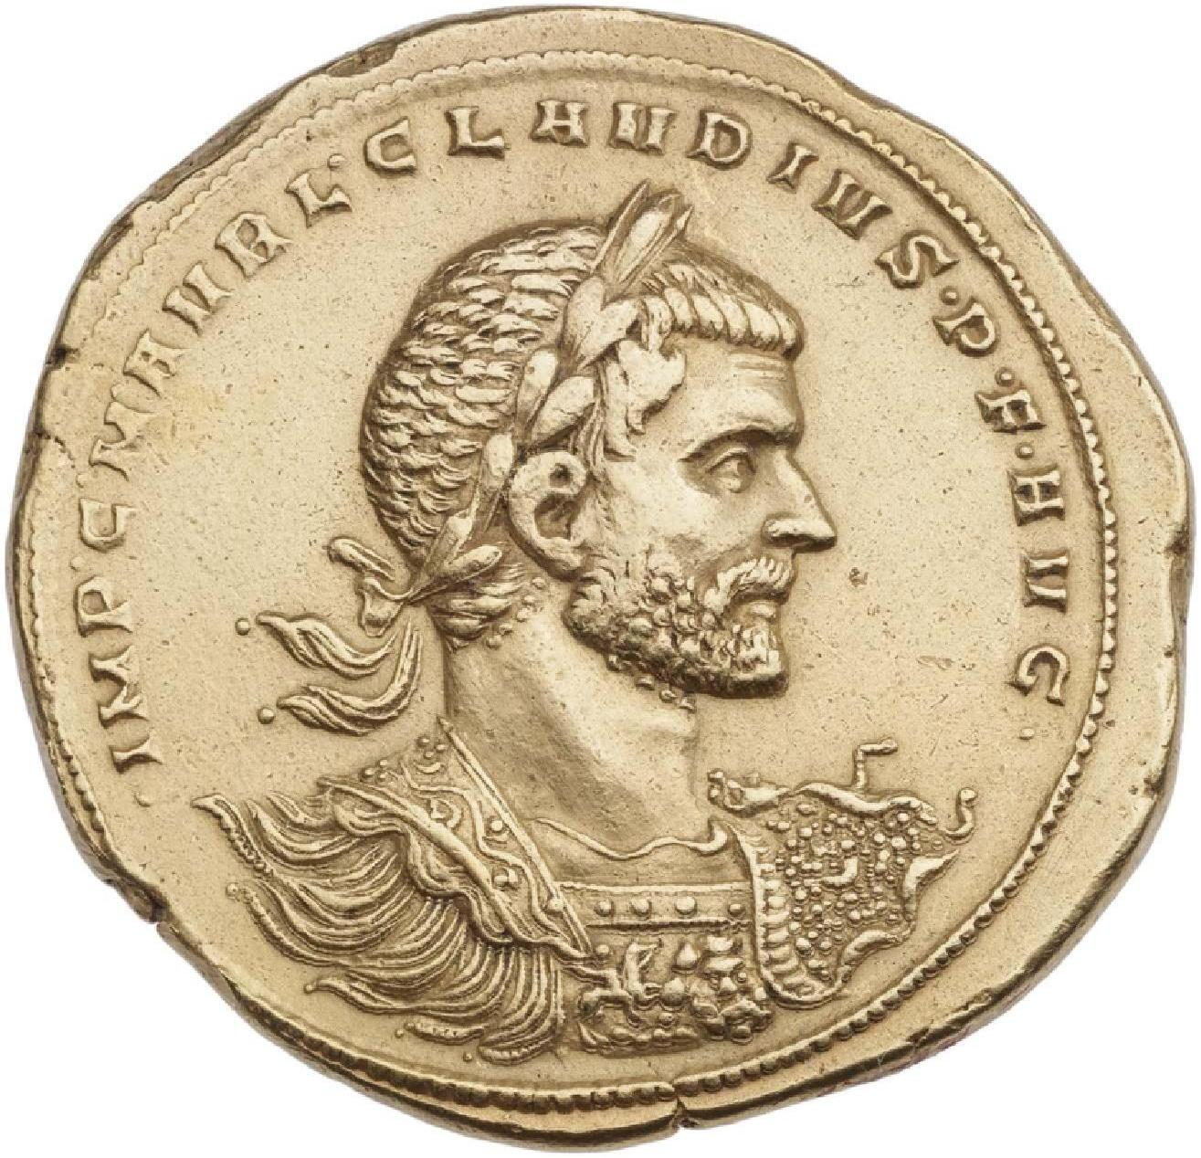
CLAUDIUS II GOTHICUS, 268-270 CE
GALLIENUS’ GENERAL (& ASSASSIN)
GAINS THE LEGIONS’ SUPPORT, OVER AURELIAN
GOTHIC VICTORIES
DIES ON CAMPAIGN, FROM THE PLAGUE
CONTROL NOW PASSES TO:

Slide 29
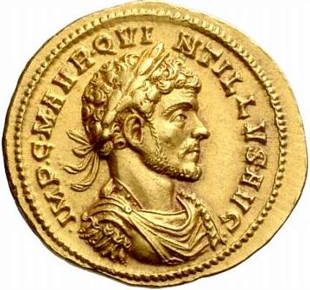
QUINTILLUS, 270 CE
CLAUDIUS II’S BROTHER
ELEVATED UPON CLAUDIUS’ DEATH
THREE-MONTH EMPEROR (AGAIN !?!)
ASSASSINATED? INSIDE JOB?

Slide 30
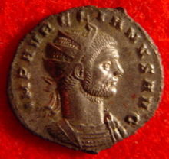
AURELIAN, 270-275 CE
GALLIENUS’ MASTER OF HORSE
LOSES THRONE TO CLAUDIUS II WHEN GALLIENUS IS KILLED
JUTHUNGI, VANDAL, GALLIC & JORDANIAN CAMPAIGNS
“RESTITUTOR ORBIS/ORIENTIS”
SOL INVICTUS CULT REVIVED
MINT, BREAD & GRAIN REFORM
ASSASSINATED BY THE PRAETORIAN GUARD (HO, HUM)

Slide 31
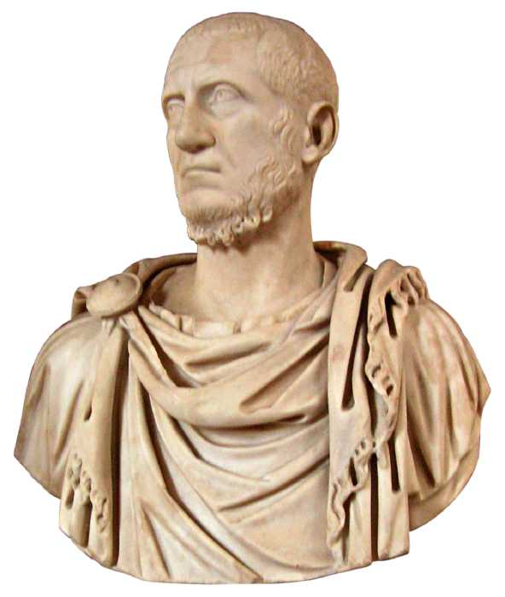
TACITUS, 275-276
OLD, SENATORIAL RANK
~8-MONTH REIGN
NOMINATED TO TAKE AURELIAN’S PLACE
DEIFIES HIS PREDECESSOR
MAKES ½ BROTHER, FLORIANUS, PRAETORIAN PREFECT
SUCCESSFUL GOTHIC CAMPAIGN
DIES (NATURALLY? OTHERWISE?)

Slide 32
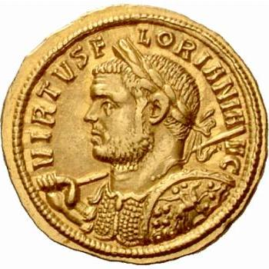
FLORIANUS, 276 CE
3-MONTH EMPEROR
QUICKLY TAKES POWER WHEN TACITUS DIES
ONLY SYRIA & EGYPT REVOLT AGAINST HIM
PROBUS, A USURPER, CHALLEGES HIM
FLORIANUS MURDERED BY HIS OWN (HO, HUM)

Slide 33
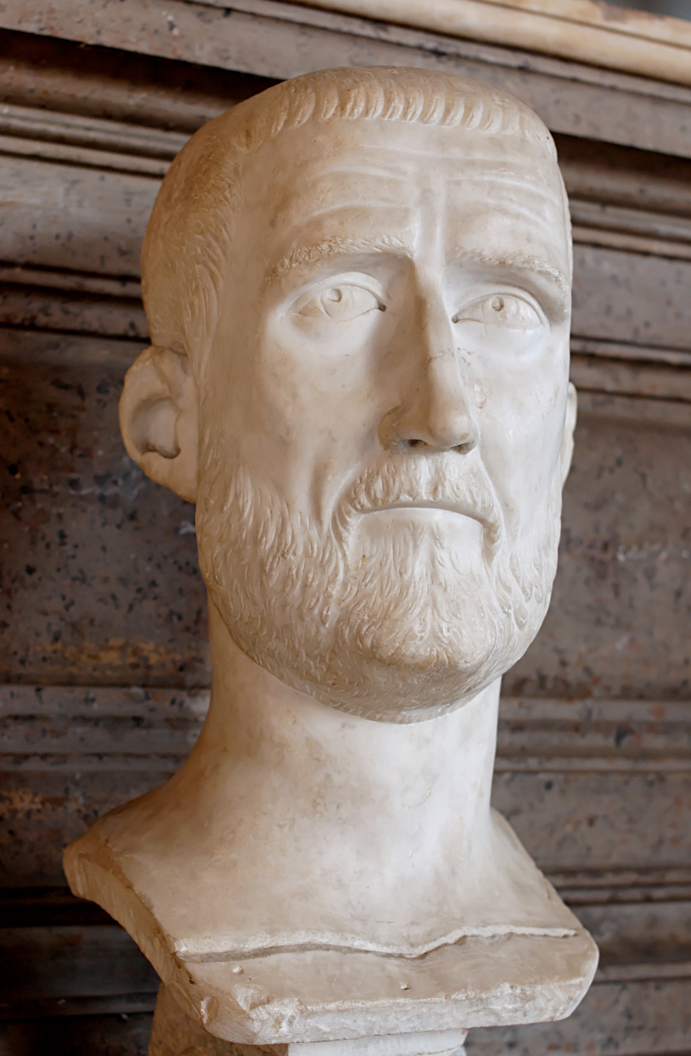
PROBUS, 276-282 CE
GENERAL UNDER AURELIAN
ASSIGNED TO EGYPT & SYRIA
WHEN TACITUS DIES/IS KILLED, DECLARES AGAINST FLORIANUS
FLORIANUS DEAD, HE HEADS TO ROME FOR SENATORIAL APPROVAL
GALLIC, GOTHIC, EGYPTIAN CAMPAIGNS; PREPARES FOR PERSIA
ANNOUNCES THE EVENTUAL END OF THE LEGIONS; ASSASSINATED

Slide 34
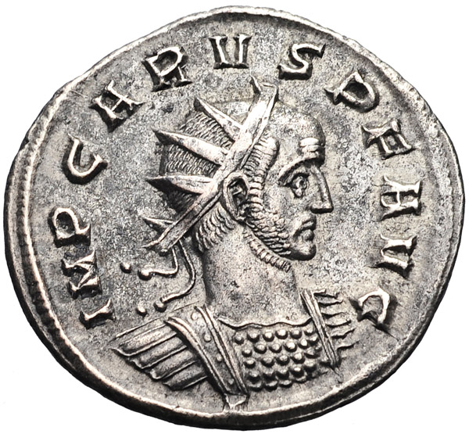
CARUS, 282-283 CE
PROBUS’ PRAETORIAN PREFECT (COINCIDENCE?)
ON DUTY IN RAETIA (AUSTRIA) WHEN PROBUS’ ARMY REVOLTS
MAKES HIS 2 SONS CAESARS
DANUBIAN & PERSIAN CAMPAIGNS SUCCESSFUL
DIES MYSTERIOUSLY (LIGHTNING? ASSASSINATION? ONLY APER HIS PREFECT KNOWS)

Slide 35
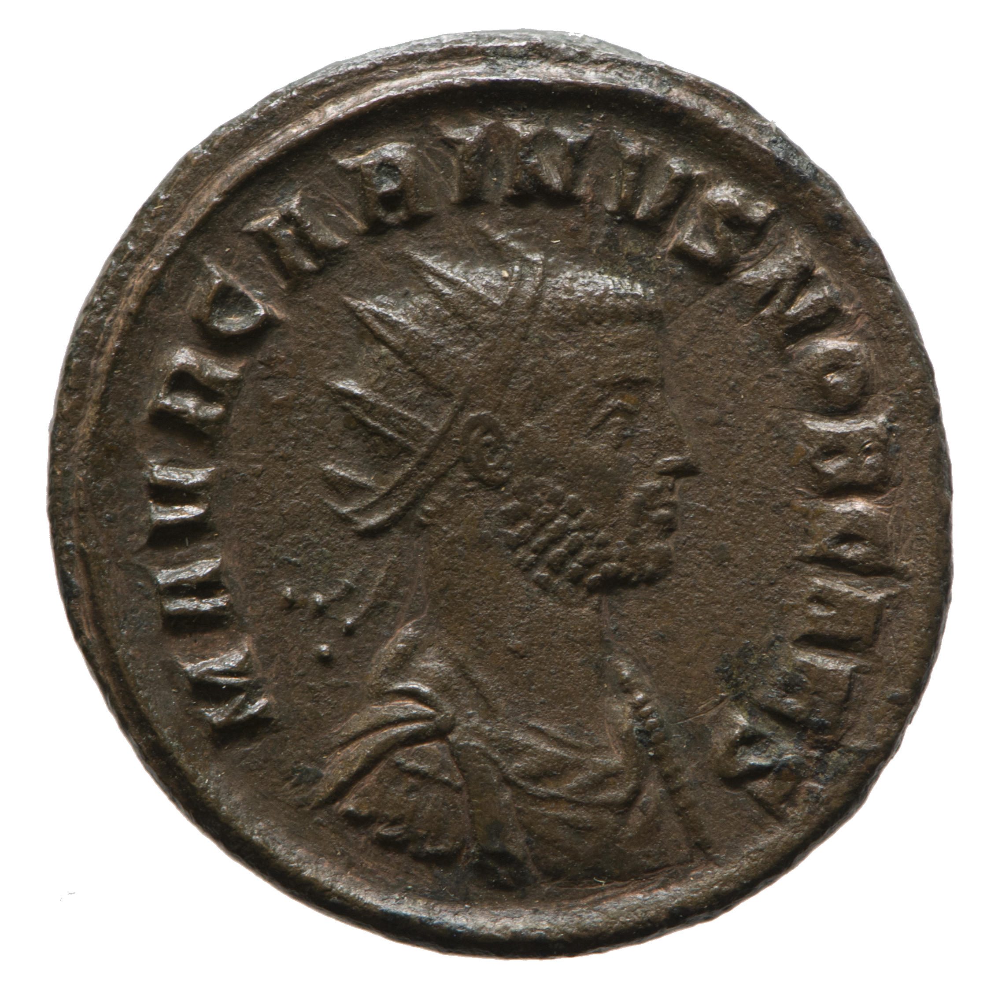
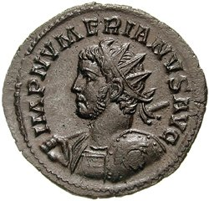
CARINUS & NUMERIAN, 283-285 CE
CARINUS—WESTERN PORTFOLIO
IN ROME WHEN HIS FATHER, CARUS, DIES
CO-EMPERORS: CARINUS IN THE WEST, NUMERIAN IN THE EAST
NUMERIAN CUTS SHORT THE PERSIAN CAMPAIGN, DIES MYSTERIOUSLY, 284; (APER HIDES IT LONG AS HE CAN) HIS LEGIONS DECLARE FOR DIOCLETIAN
CARINUS, CAMPAIGNING AGAINST DIOCLETIAN, MURDERED (JEALOUSY?)

Slide 36
WELCOME TO THURSDAY !!

Slide 37
THE FINAL BODY COUNT, 235-285 CE:
16 MURDERED BY THEIR OWN AND/OR BY PRAETORIANS: (MAXIMINUS, GORDIAN II, PUPIENUS, BALBINUS, GORDIAN III, PHILIP, GALLUS, AURELIANUS, GALLIENUS, POSTUMUS, QUINTILLUS, AURELIAN, FLORIAN, PROBUS, CARUS, NUMERIAN)
1 IN BATTLE (DECIUS)
1 BY SUICIDE (GORDIAN I)
1 CAPTURED/KILLED IN PERSIA (VALERIAN)
1 ON CAMPAIGN (PLAGUE?) (CLAUDIUS II)
1 BY NATURAL CAUSES (TACITUS)
1 BY A JEALOUS HUSBAND (!?!) (CARIANUS)

Slide 38
CHAOS, OR CONVENTION?
SUCCESSION PROCESS, PREVIOUSLY ESTABLISHED, STILL HOLDS
(SLIGHTLY ACCELERATED, HOWEVER)
ATTEMPTS AT DYNASTIC SUCCESSION FAIL (PREDICTABLY)
NO REAL INNOVATIONS IN HOW AUTHORITY IS ESTABLISHED
PORTFOLIOS (EAST & WEST) DICTATED BY DIRECT MILITARY CHALLENGES

Slide 39
QUESTION:
AT THIS POINT DOES ROME NEED AN EMPEROR, OR A MANAGER?

Slide 40
A LITANY OF VULNERABILITIES:
CAN’T TRUST THE PRAETORIAN GUARD (OR ITS PREFECTS)
OATHS TO GENERALS (INSTEAD OF TO ROME) MEAN THAT LEGIONS CAN ELEVATE OR FIRE (& KILL) EMPERORS AT WILL
SENATORIAL MEDDLING IN IMPERIAL & MILITARY AFFAIRS CREATES A BI-POLAR SYSTEM OF GOVERNANCE & DEFENSE
BORDER REGIONS NORTH & EAST ARE EXTREMELY VULNERABLE
TAX REVENUES TANK, LEADING TO CURRENCY DEVALUATION
CURRENCY DEVALUATION LEADS TO HYPER-INFLATION, LEADING TO TAXES-IN-KIND FOR THE ARMY (ANNONA MILITARIS)
PAST ATTEMPTS AT A STABLE SUCCESSION FAIL MISERABLY

Slide 41
A FEW (EARLY) SOLUTIONS
GALLIENUS CUTS OFF SENATE ACCESS TO THE MILITARY, AND VICE VERSA (SOLDIERS STAY SOLDIERS)
GALLIENUS CREATES A MOBILE, CAVALRY-BASED FORCE, BASES IT IN MEDIOLANUM (MILAN), NOT ROME
AURELIAN BUILDS EXTENSIVE DEFENSIVE WALLS AROUND ROME
AURELIAN ABANDONS THE PROVINCE OF DACIA (‘WRONG’ SIDE OF THE DANUBE, HARD TO DEFEND)

Slide 42
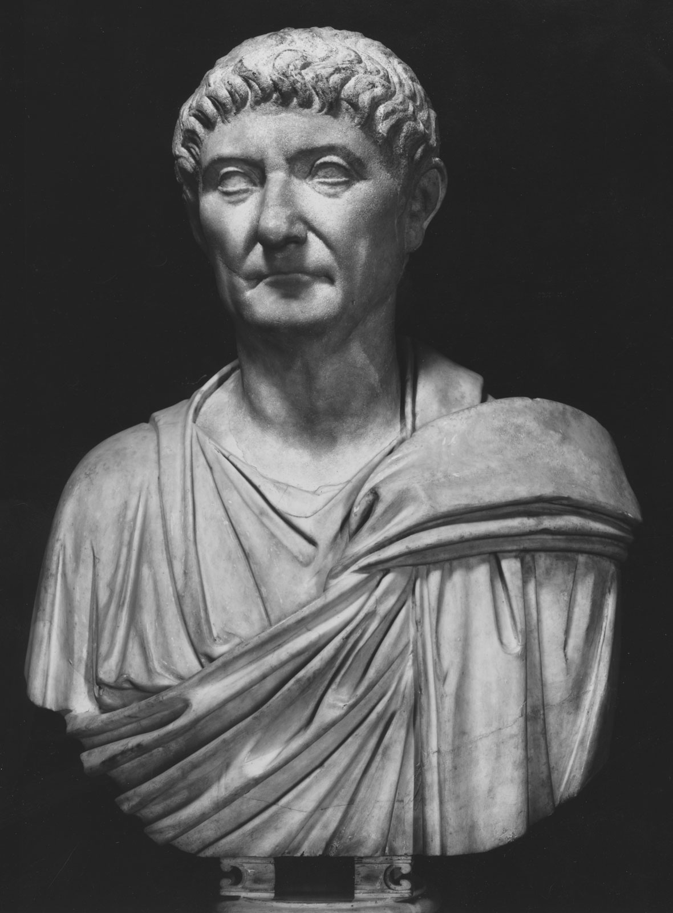
DIOCLETIAN, 284-305 CE
ONE OF NUMERIAN’S PROTECTORES (SEMI-PRIVATE BODYGUARD)
ACCLAIMED ONCE NUMERIAN’S DEATH BECOMES KNOWN, (AFTER KILLING APER, OF COURSE)
285 CE—UPON CARINUS’ MURDER, HIS RISE TO POWER IS COMPLETE

Slide 43
ENTER DIOCLETIAN THE MANAGER:
286—ELEVATES MAXIMIAN TO CAESAR, THEN AUGUSTUS:
PORTFOLIOS: DIOCLETIAN—EAST, MAXIMIAN—WEST
293— “CAESARS” APPOINTED, GALERIUS—EAST, CONSTANTIUS—WEST (THE TETRARCHY IS BORN)
TO EACH TETRARCH A FIELD ARMY (COMITATENSIS); & A PRAETORIAN PREFECT FOR ADMINISTRATION
SUCCESSFUL CAMPAIGNS IN PERSIA, EGYPT, BRITAIN

Slide 44
DIOCLETIAN’S PROVINCIAL REFORMS:
NUMBER OF PROVINCES NEARLY DOUBLED (FROM 47 TO 85)
PROVINCES THEN ORGANIZED INTO DIOCESES (12)
EACH PROVINCIAL GOVERNOR ANSWERS TO A DIOCESAN VICARIUS (‘DEPUTY’)
EACH VICARIUS ANSWERS TO 1 OF THE 4 (ADMINISTRATIVE) PRAETORIAN PREFECTS
EACH PRAETORIAN PREFECT ANSWERS TO EITHER AN AUGUSTUS OR A CAESAR
(BY THE NUMBERS: 100—12—4—1 (DIOCLETIAN) )

Slide 45
OFFICIAL RESIDENCES:
AUGUSTUS OF THE EAST: NICOMEDIA (BITHYNIA, PONTUS) —THEN ANTIOCH (SYRIA, ORIENTIS)
AUGUSTUS OF THE WEST: RAVENNA (GALLIA CISALPINA)
CAESAR OF THE EAST: THESSALONICA (MACEDONIA)
CAESAR OF THE WEST: TRIER (GALLIA BELGICA)
(—NOTE: ROME NOW IRRELEVANT)
CONSTANTIUS HAS A SON, CONSTANTINE, THROUGH AN EARLY LIAISON WITH HELEN (BOTH PLEBEIANS, SO—NOT MARRIED)
QUESTION: WERE CONSTANTIUS & HELEN CHRISTIAN?

Slide 46
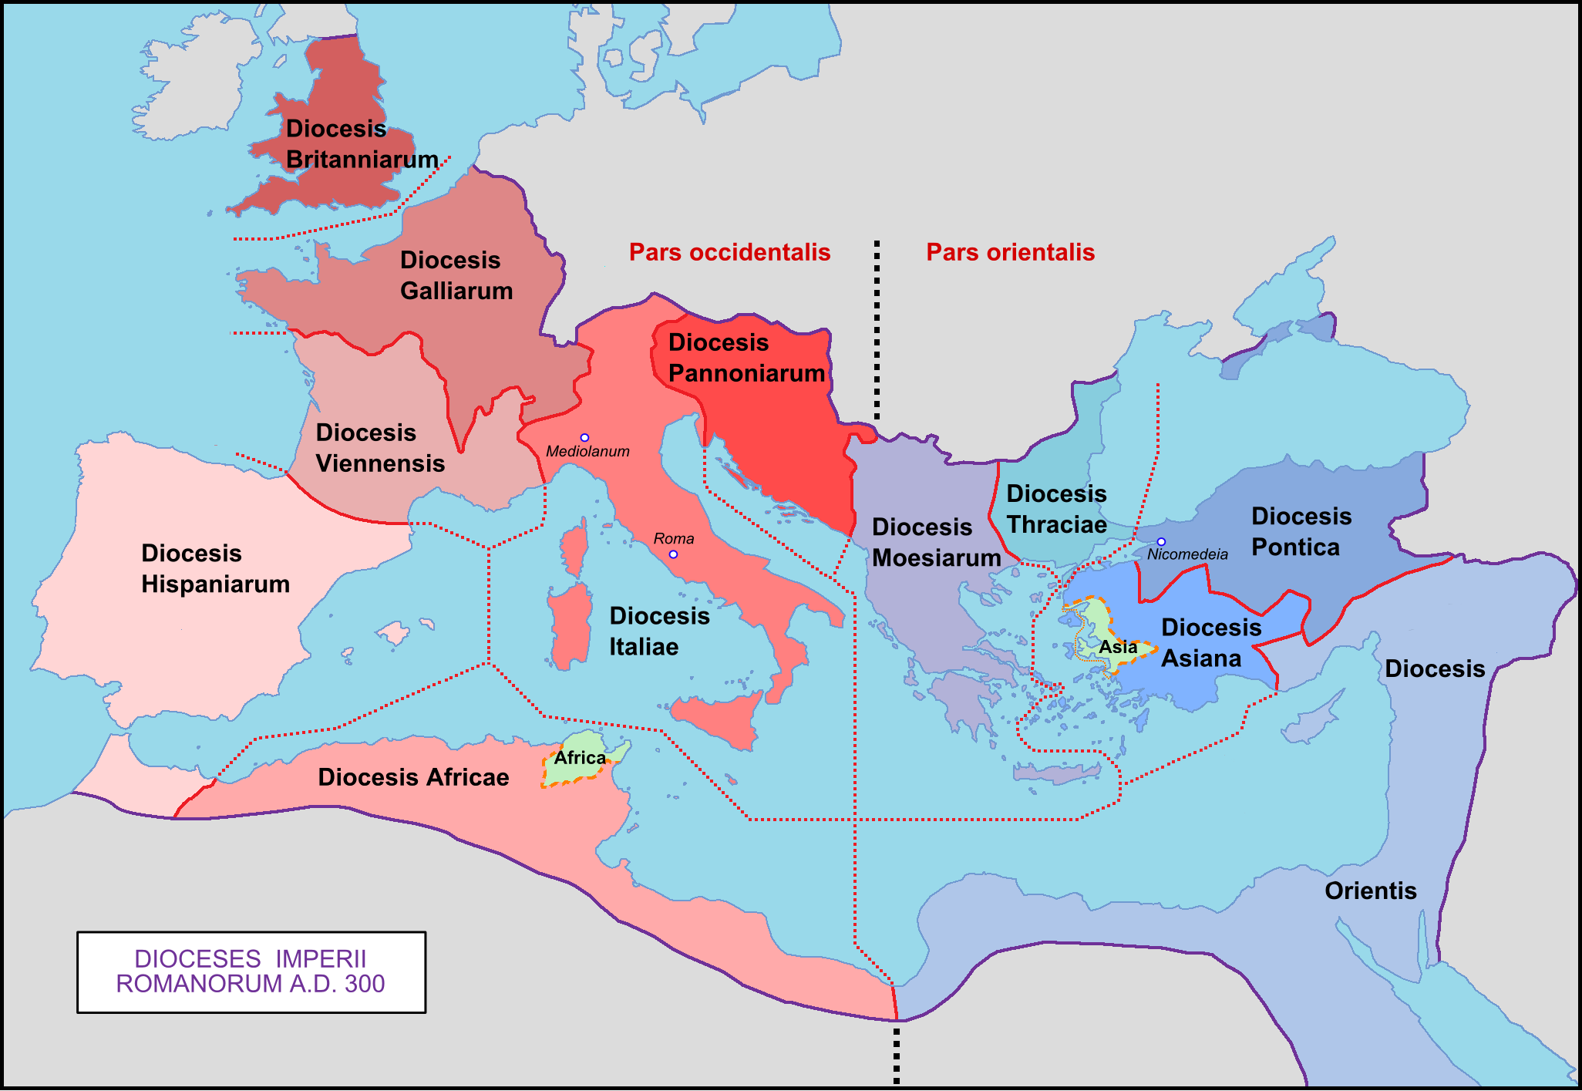

Slide 47
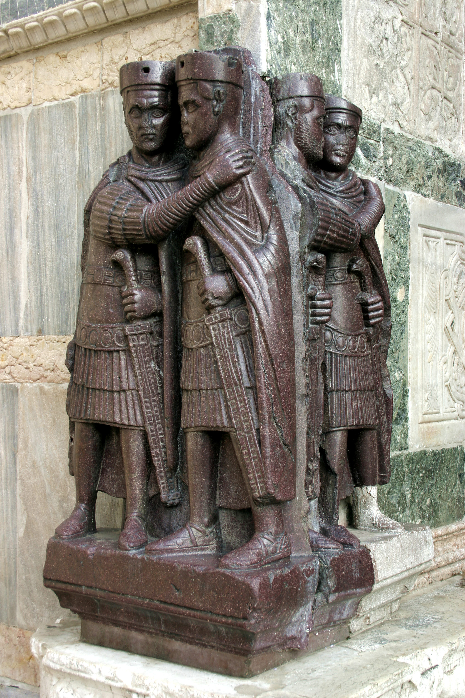
THE TETRARCHS: PORPHYRY SCULPTURE (EGYPTIAN MARBLE), FORMERLY IN CONSTANTINOPLE; STOLEN IN 1204 (4TH CRUSADE) & INSTALLED IN VENICE (SEE ALSO p. 474)

Slide 48
OTHER INNOVATIONS:
NEW BASIS FOR TAXATION: CAPUT & JUGUM
NOW-ANNUAL TAX ASSESSMENTS (REGULAR, PREDICTABLE)
NEW CURRENCY—BUT STILL DEVALUED
HYPER-INFLATION REMAINS A CONCERN, so…
WAGE & PRICE CONTROLS INTRODUCED
PROBLEMS PERSIST, so…
CHRISTIANS SYSTEMATICALLY PERSECUTED, then
MANICHEANS SYSTEMATICALLY PERSECUTED

Slide 49
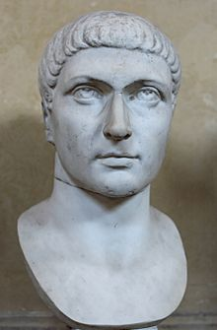
CONSTANTINE I, 306-337 AD
SON OF SOLDIER CONSTANTIUS CHLORUS (LATER, CAESAR & AUGUSTUS)
HIS MOTHER, HELEN, IS DITCHED IN FAVOR OF A DYNASTIC MARRIAGE (THEODORA, MAXIMIAN’S DAUGHTER)
NEXT—SOLDIER/HOSTAGE OF GALERIUS
EYEWITNESS TO CHRISTIAN PERSECUTIONS
NOT ORIGINALLY INTENDED FOR POWER (BUT WHEN HIS DAD DIES…)

Slide 50
RETIREMENT & MAYHEM
DIOCLETIAN INSTITUTES A ‘TERM LIMIT’ FOR AUGUSTI, INSISTS THAT MAXIMIAM RETIRE ALONG WITH HIM—305 CE
CONSTANTIUS & GALERIUS ARE NOW AUGUSTI, WEST & EAST
CONSTANTIUS ASKS GALERIUS FOR HIS SON, CONSTANTINE, TO ACCOMPANY HIM ON CAMPAIGN IN BRITAIN
306 CE—CONSTANTIUS DIES IN YORK (EBORACUM); CONSTANTINE SALUTED AS EMPEROR BY DAD’S LEGIONS
(PROBLEM: SEVERUS WAS ALREADY CAESAR…)
(NEXT PROBLEM: SEVERUS ASSASSINATED, MAXIMIAN UN-RETIRES, ALLIED WITH HIS SON MAXENTIUS)

Slide 51
MARRIAGE, ROMAN STYLE:
CONSTANTINE AGREES TO MARRY FAUSTA, MAXIMIAN’S DAUGHTER (& MAXENTIUS’ SISTER), BECOMES AUGUSTUS OF BRITAIN AND GAUL
MAXENTIUS GETS ROME & AFRICA—BUT WANTS IT ALL
MAXIMIAN, EXILED BY HIS OWN SON, TAKES REFUGE WITH HIS SON-IN-LAW, but…
310—MAXIMIAN TRIES TO DEPOSE CONSTANTINE, DIES UNDER A SIEGE AT MASSALIA (MARSEILLES)

Slide 52
MEANWHILE, IN THE EAST…
GALERIUS, NOTORIOUS FOR HIS PERSECUTIONS, FALLS DESPERATELY, PAINFULLY ILL
HE IDENTIFIES HIS SYMPTOMS AS DIVINE VENGEANCE
311 CE—HE ISSUES A DECREE OF TOLERANCE FOR CHRISTIANS, THEN DIES
THE TEXT OF HIS DECREE IS PRESERVED BY CHRISTIAN AUTHORS (WHO ALL TOO GLEEFULLY DESCRIBE HIS PAINFUL DEATH)

Slide 53
ABOUT THE EDICT OF MILAN
UNDER THE TETRARCHY, EDICTS OF ANY AUGUSTUS MUST BE HONORED BY ALL AUGUSTI & CAESARS: so…
THIS EDICT IS MERELY A “RESCRIPT” OR REMINDER: CHRISTIAN PERSECUTIONS MUST CEASE, PER GALERIUS’ EDICT
THE ‘EDICT’ IS ISSUED IN 313 CE; 53 YEARS AFTER GALLIENUS’ EDICT, 2 YEARS AFTER GALERIUS’
ITS DISTINCTION? THIS TIME, IT REMAINED ON THE BOOKS (LICINIUS’ OBJECTIONS NOTWITHSTANDING…)

Slide 54
ADOPTION & LEGITIMACY
CONSTANTINE HAS THE SENATE CONFIRM HIS FATHER’S ‘ANCESTRY’—VIA AN AFTER-THE-FACT ‘ADOPTION’— BY AN HONORED PREDECESSOR—CLAUDIUS II GOTHICUS
CLAUDIUS’ MILITARY EXPLOITS (GOTHICUS MAXIMUS) HELPED TO DETERMINE THE CHOICE

Slide 55
SOL INVICTUS (A REMINDER)
LONG REGARDED AS A DIVINE PRESENCE
BOTH A METAPHOR, AND A GOD IN HIS OWN RIGHT
MITHRAS CULT ASSOCIATED WITH THE RISING SUN
ELAGABALUS’ ATTEMPT AT ELEVATING THE SYRIAN SUN GOD ABOVE JUPITER FAILS, but…
274 CE—AURELIAN DEDICATES A TEMPLE TO SOL INVICTUS (HIS DATE OF BIRTH—DECEMBER 25)
CONSTANTIUS & CONSTANTINE REGARD SOL INVICTUS, ALSO IDENTIFIED WITH APOLLO, AS THEIR PATRON DEITY (GENIUS)

Slide 56
WHEN DID CONSTANTINE CONVERT?
SYNCRETISM IS THE WILD CARD HERE
INITIALLY SOL INVICTUS WAS HIS PATRON DEITY; BUT AFTER THE VISION OF MILVIAN BRIDGE, HE INCREASINGLY WROTE IN CHRISTIAN TERMS
PROBLEM: HE MUST AVOID BAPTISM WHILE EMPEROR
ANOTHER PROBLEM: HE HAS HIS ELDEST SON & WIFE FAUSTA MURDERED (A FAILED COUP ATTEMPT) IN 326 CE
CONSTANTINE’S SOLUTION? HE WAITS UNTIL HE IS ON HIS DEATHBED TO BE BAPTIZED, IN 337 CE

Slide 57
WHAT KIND OF CHRISTIAN WAS HE?
AS PONTIFEX MAXIMUS, HE INSISTS ON ESTABLISHING CHURCH DOCTRINE (FROM PAX DEORUM TO PAX DEI)
HIS FIRST LOCAL BISHOPS’ COUNCIL – ARLES, 314 CE
THE DISPUTE: HOW TO HANDLE CHRISTIAN CLERGY WHO ALLEGEDLY ‘LAPSED’ UNDER PERSECUTION
DONATIST POSITION: THEIR RITUALS, ESPECIALLY BAPTISM, ARE NO LONGER VALID—DEPOSE THEM ALL !!
‘MAINSTREAM’ POSITION: THEY ARE FORGIVEN; THEIR BAPTISMS REMAIN VALID, DITTO THEIR EUCHARISTIC SERVICES
CONSTANTINE’S POSITION? COMPLETE EXASPERATION…

Slide 58
CONSTANTINE THE BISHOP:
FIRST WORLD (ECUMENICAL) COUNCIL MEETS IN NICAEA, 325 CE
CONSTANTINE, AS PONTIFEX MAXIMUS, INSISTS ON HIS EQUALITY WITH CHRISTIAN BISHOPS (A GRATEFUL CLERGY AGREES—THIS TIME)
THE DISPUTE: BISHOP ARIUS OF ALEXANDRIA’S CONTENTION THAT JESUS WAS/IS LESSER THAN GOD
THE MAINSTREAM POSITION: JESUS IS EQUAL WITH GOD; LANGUAGE FOR THE CONFESSION OF THE FAITH ESTABLISHED
(THE NICENE CREED)
(CONSTANTINE’S POSITION? BAPTIZED BY AN ARIAN BISHOP)

Slide 59
CONSTANTINE’S APOTHEOSIS

Slide 60
SAINTS CONSTANTINE & HELEN

Slide 61
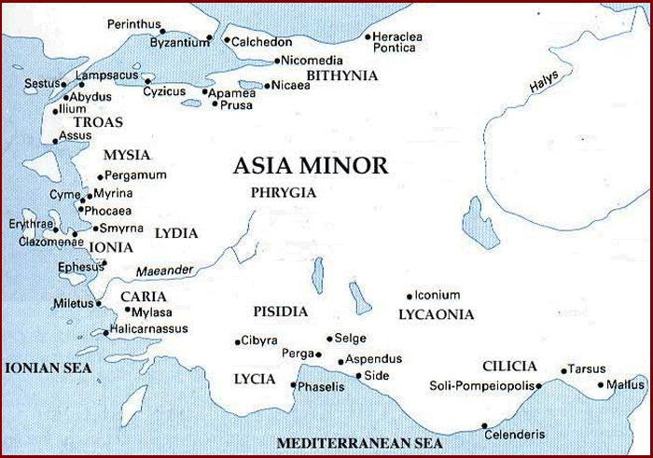
WHY BYZANTIUM?

Slide 62
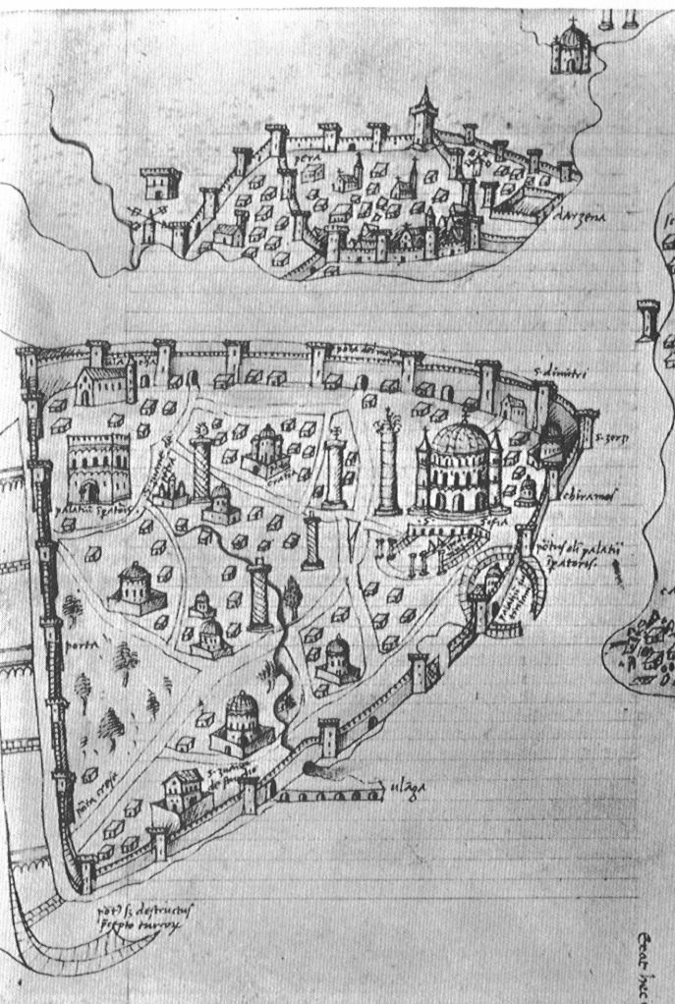
BYZANTIUM
BECOMES
“NEW ROME,”
THEN
“CONSTANTINOPLE,”
THE NEW CAPITOL OF…

Slide 63
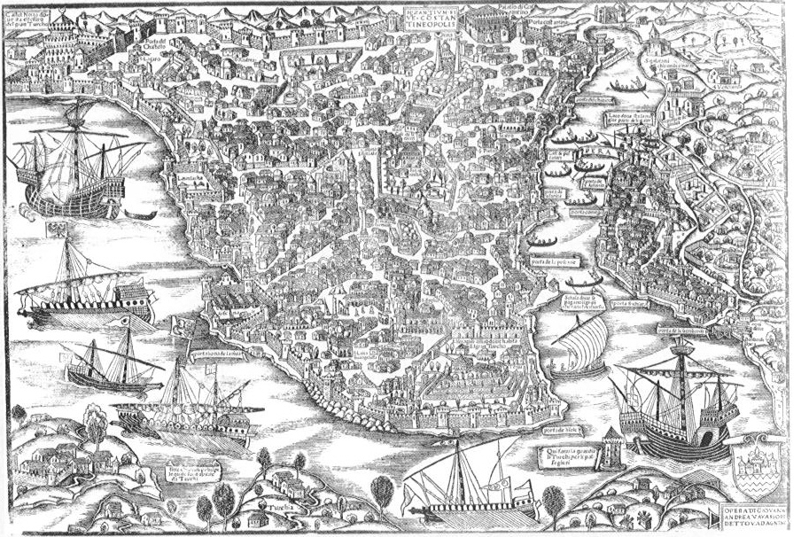
THE (EASTERN) ROMAN EMPIRE, 330-1453 CE

Slide 64
QUESTION:
WHAT’S A CHURCH?

Slide 65
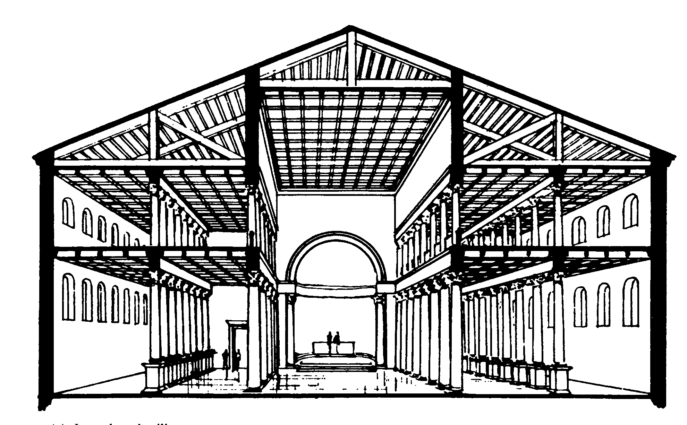
THE BASILICA
[“IMPERIAL HALL”]

Slide 66
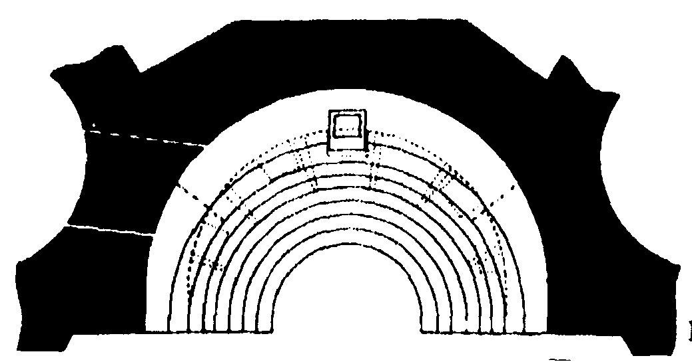
SYNTHRONON, APSE, & IMPERIAL THRONE

Slide 67
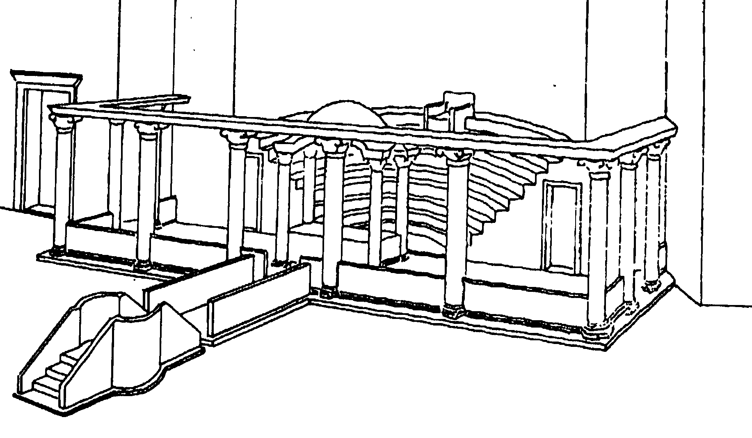
THE SANCTUARY

Slide 68
TUNE IN NEXT WEEK FOR:
ROME, ITS STRUCTURES, ITS DAILY LIFE

